Slide 1

Modeling House Prices with Regression

Slide 2
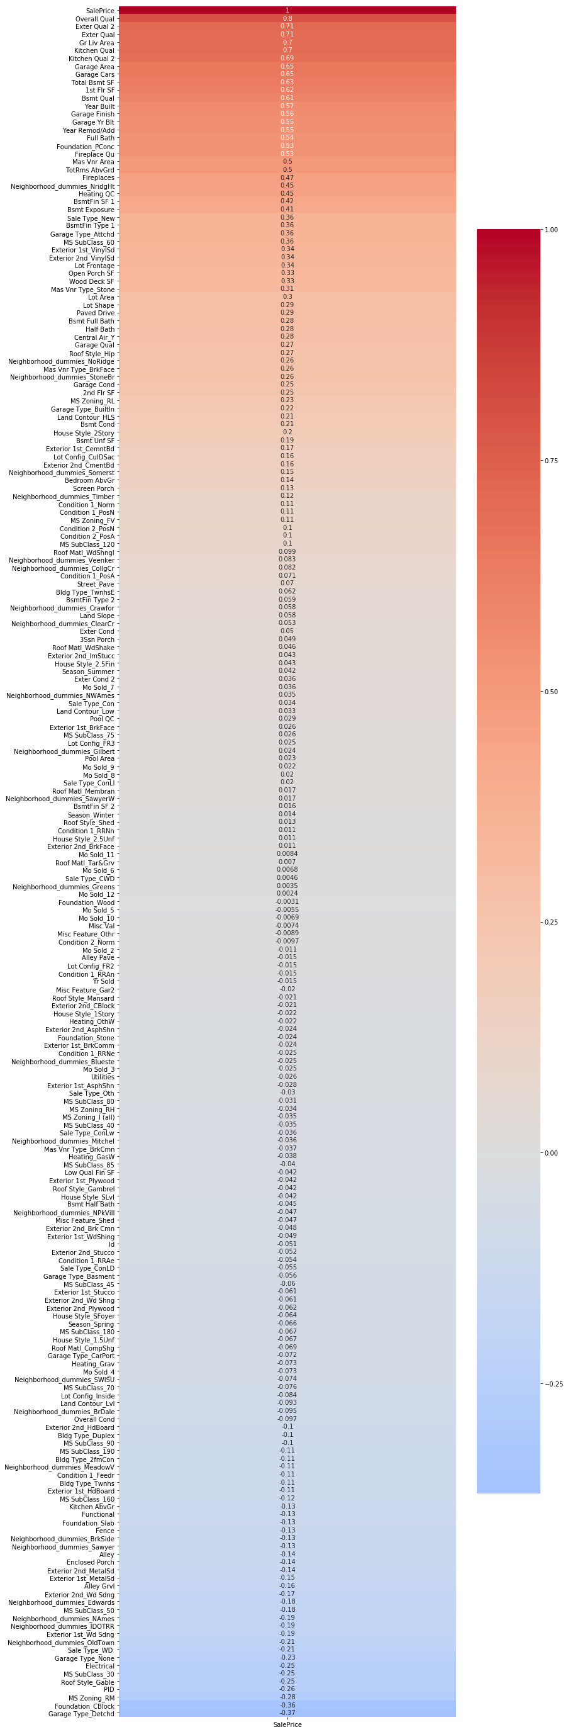
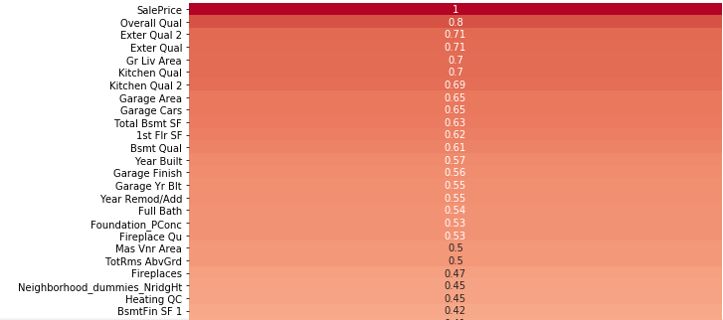
The Ames Housing Dataset
Ames, Iowa: small midwestern city north of Des Moines
Data from the Ames Assessor’s Office, used for computing assessed values
  2930 observations, 82 variables
Regression relies on numerical data
Variable types leave some things open to interpretation
  e.g Neighborhoods, Land Slope, Lot Shape, Heating Type
Holistic approach to data cleaning
Dealing with null values
  Lot Frontage
  Garage/Basement variables
Correlation chart

Slide 3
GridSearch with ElasticNet
Basic principles of regression, Ridge and Lasso
  Minimizing reducible error
  Regularization
    Structural penalties to prevent overfitting
    Alpha parameter determines the strength of the penalty
  Standardizing data
ElasticNet and GridSearchCV
  Finding a balance between Ridge and Lasso with the Rho (or l1 ratio) parameter
  Automating hyperparameter testing and cross validation
Iterating on the model with feature selection
  Eliminating irrelevant or redundant variables
  Feature engineering, Composite scores, Interaction effects

Slide 4
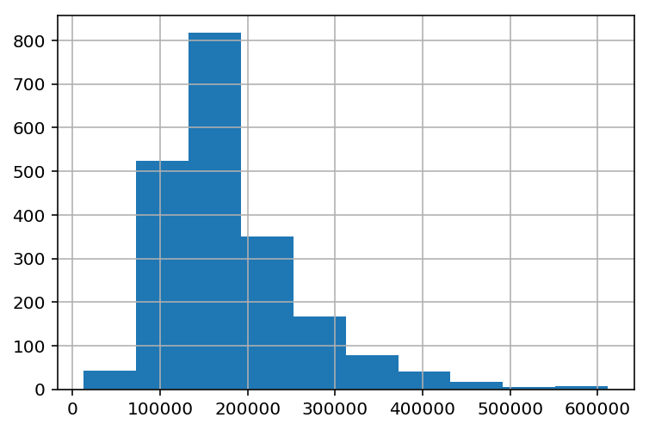
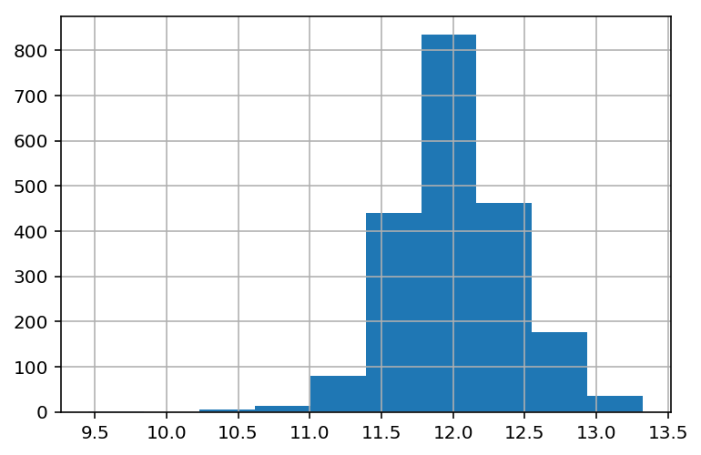
Log Transformation of Sale Prices
Log Transforming the Sale Price allows us to normalize residuals

Slide 5
K Nearest Neighbors Regression
Sklearn method in the neighbors subpackage
Analogous to the more famous K Nearest Neighbors Classifier method
The regression prediction is based in calculating an average position of the k nearest neighbors in multidimensional space.
  So imagine multidimensional coordinates based on the combination of a house’s X variable values. The training set provides a bunch of examples of coordinate combinations matched with target prices. For the test set, where the target is unknown, each test house has known X-coordinates and unknown price. The KNN model takes the k nearest X-coordinate neighbors from the training set and returns the average of their prices as the predicted price for the test house.
  This involves certain variables: weight (uniform v distance); method of distance calculation, and of course number of neighbors k.
Implementation with GridSearch

Slide 6
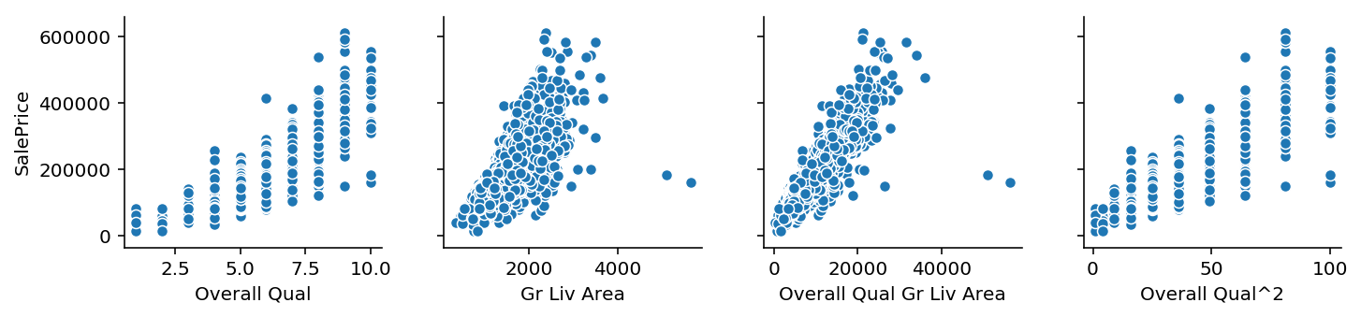
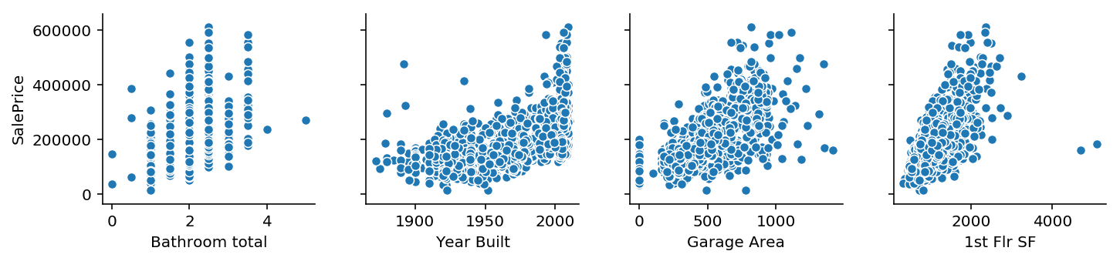
Key Variables

Slide 7
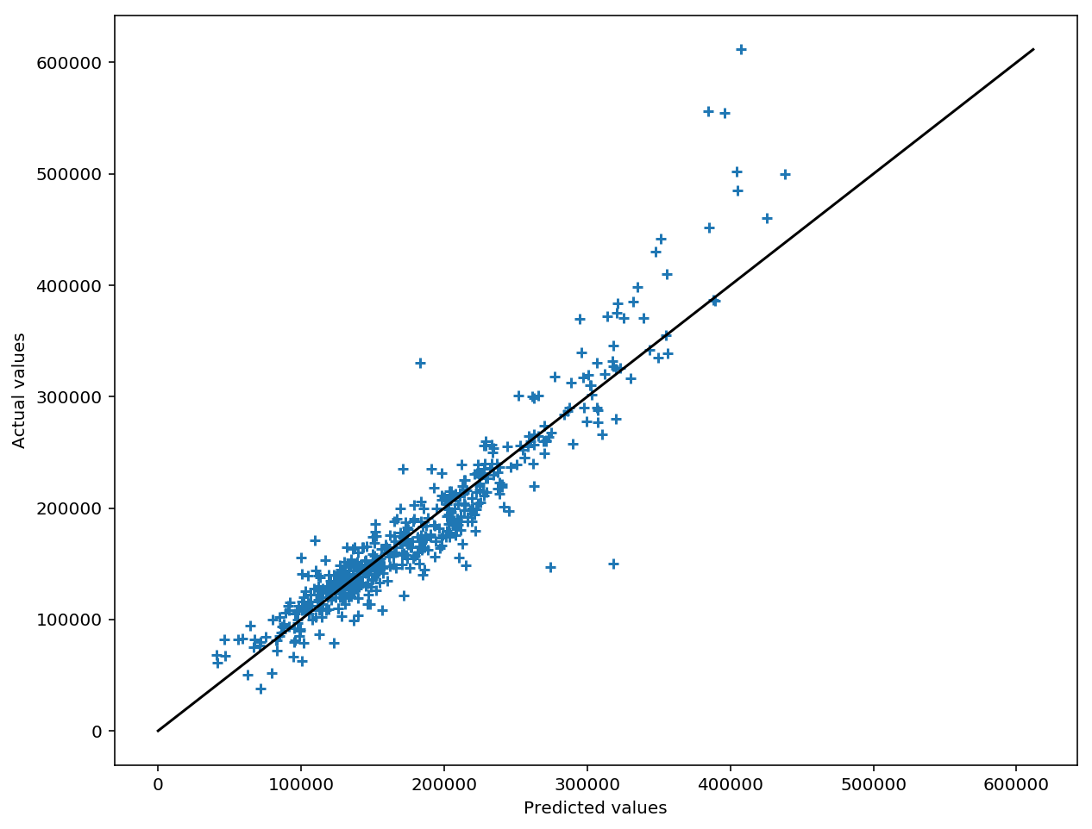
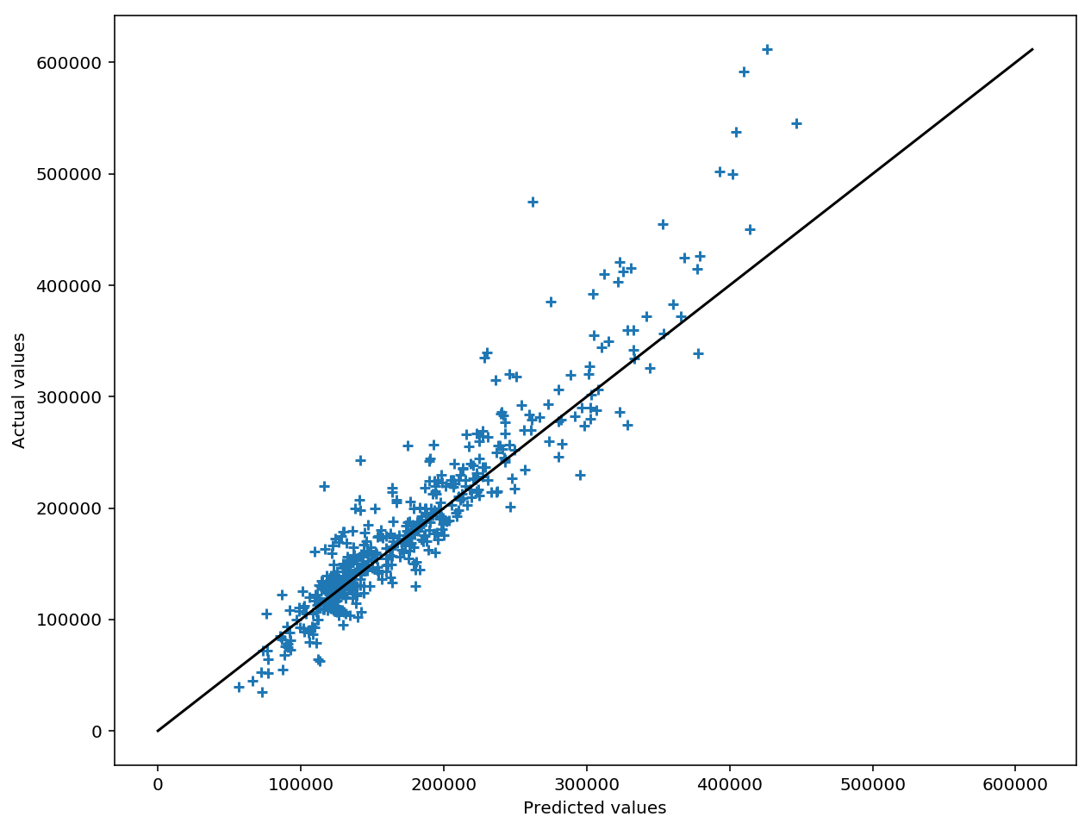
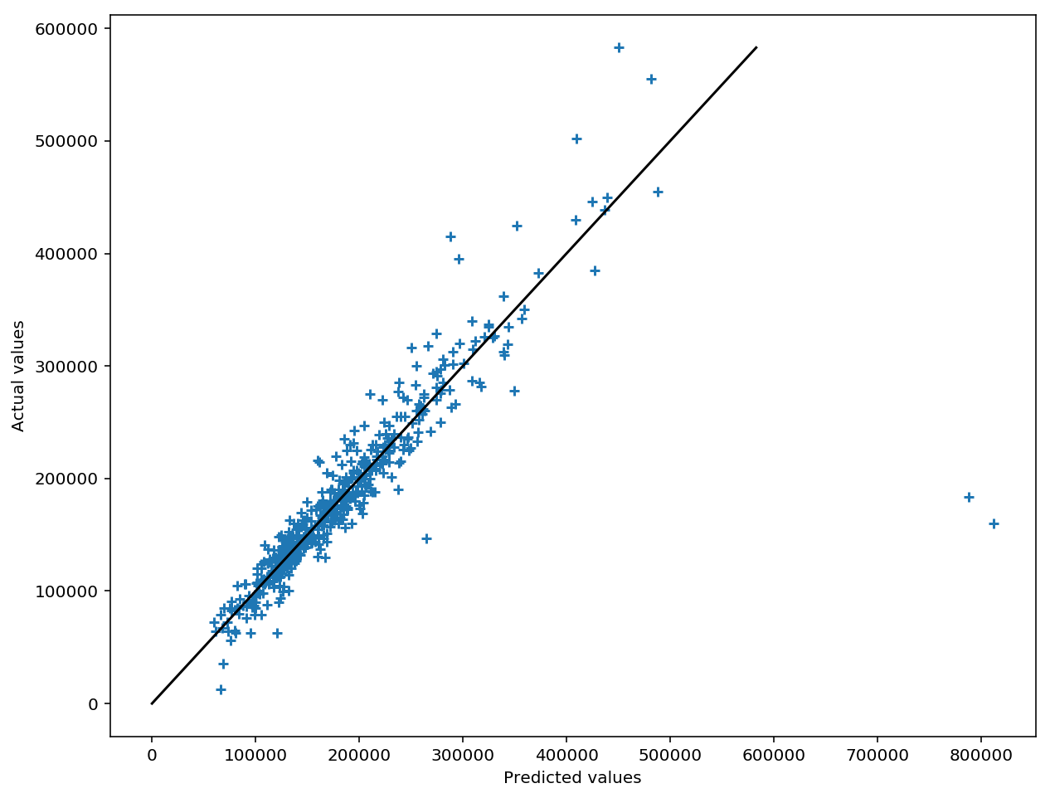
Visualizing Model Improvement
Initial Model KNN Regression Final Model
Takeaways as a student of modeling, alternate strategies

